Slide 1

Build the Enlightened Enterprise
An Overview of the Travel Agency Demo
with migration to Fuse micro-services
Powered by JBoss Enterprise Middleware -
Red Hat JBoss BPM Suite

Slide 2














JBoss Middleware becomes strategic
STRATEGY
PROCESSES
OPERATIONS
PEOPLE IT RESOURCES
Notes:
BPM Suite helps organizations to model and automate business processes combining people, data and applications, in all scenarios, from traditional to open hybrid cloud.

Slide 3

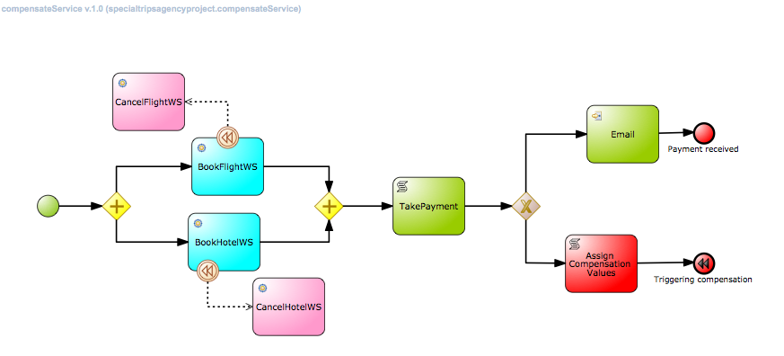
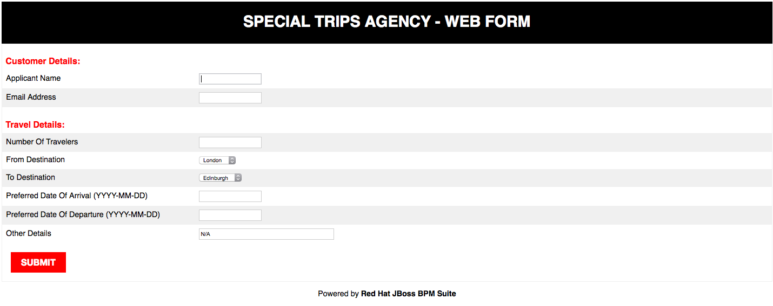
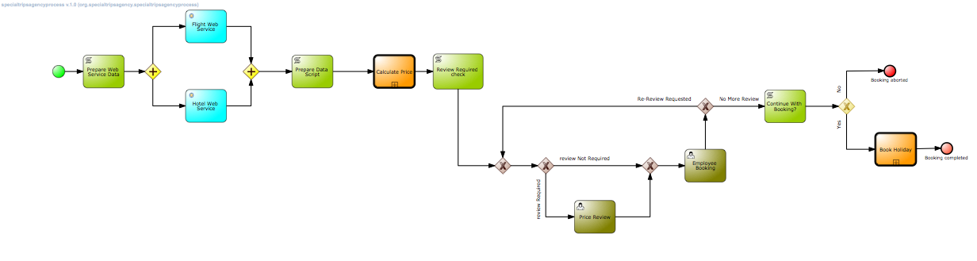
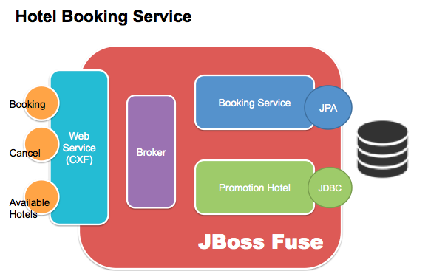
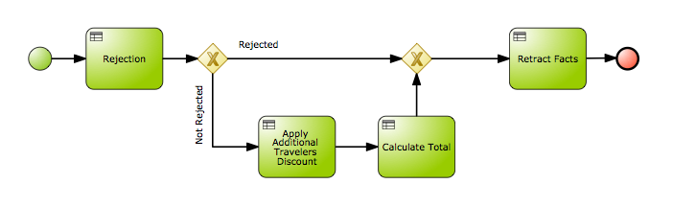
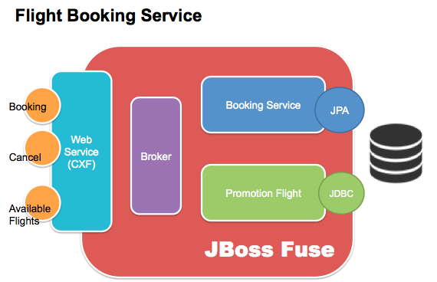
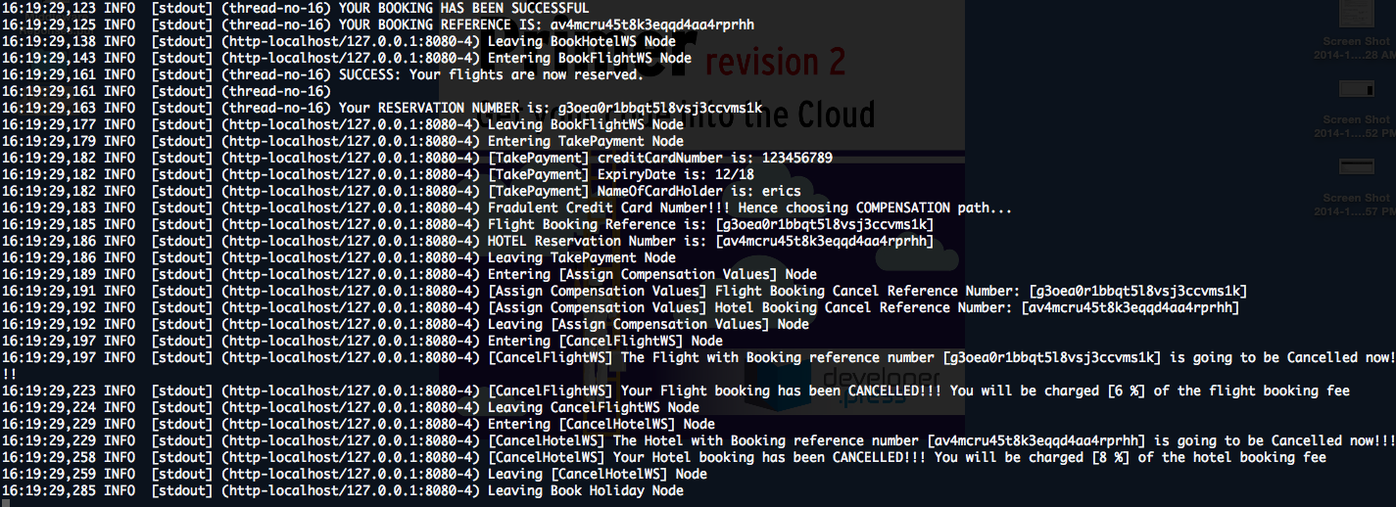
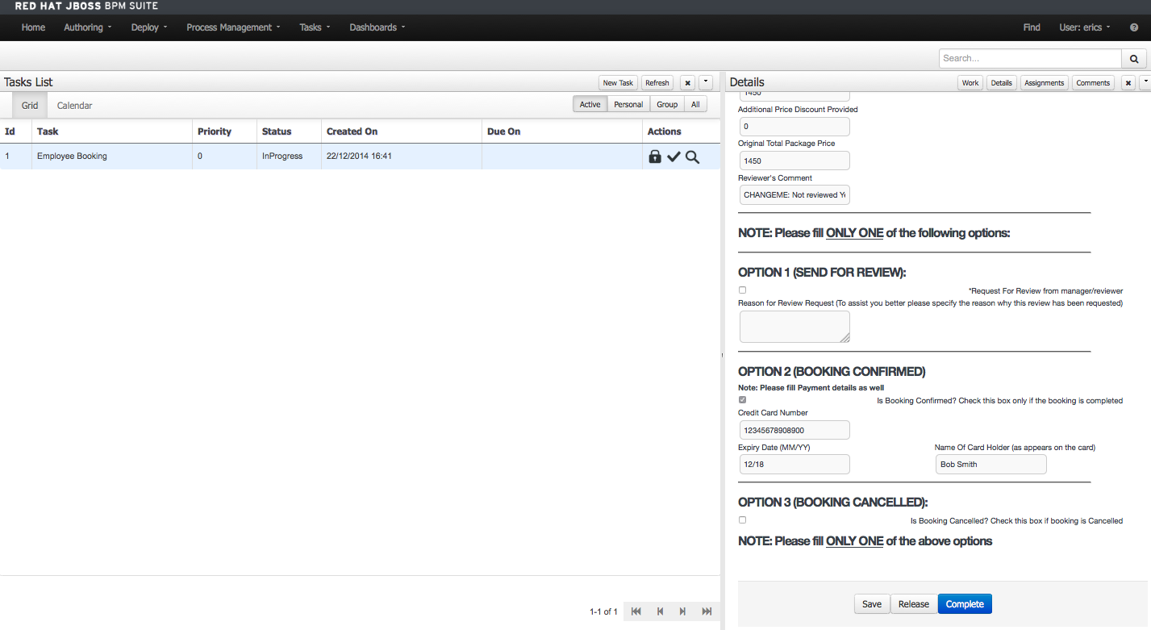
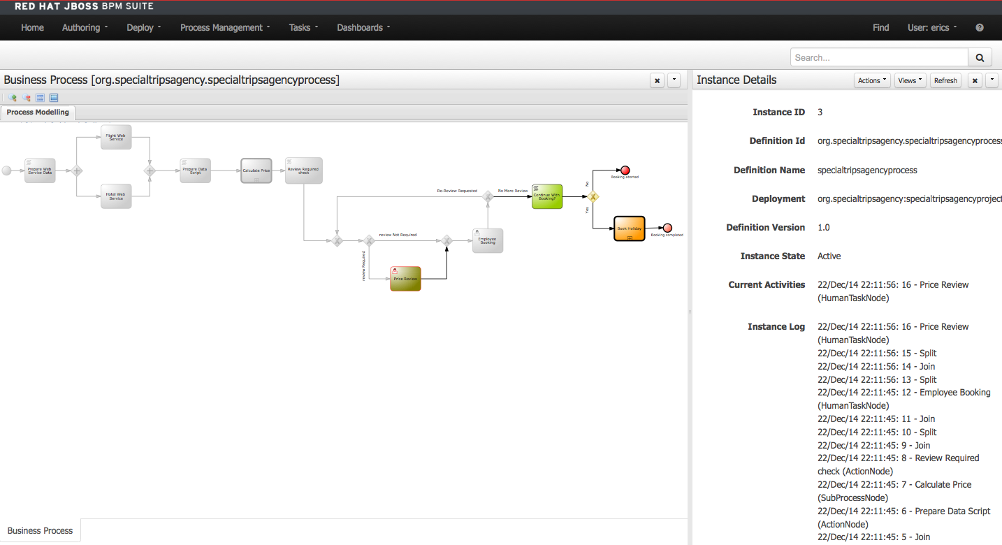
Components in JBoss BPM Travel Agency project

Slide 4







Value Proposition
Automate
business operations
with intelligent
decision support
Optimize
business operations
with real-time BAM, analytics,
simulation and reccomendation
Accelerate
application development
with model-driven
design and integration
AHA!
HYBRID CLOUD
PRIVATE
CLOUD
PUBLIC
CLOUD
Empower
business users to
take control of operations
Collaborative working
during the entire process life cycle
and beyond the Enterprise
Deploy
in the Cloud
with BPM PaaS

Slide 5





Capabilities Overview
Processes Create and deploy enterprise processes and applications through a model-driven composition environment and execution platform. | Services Integrate and interoperate your existing enterprise systems and web services in your business processes using JBoss SOA Platform and JBoss Fuse modern ESB.
Rules JBoss BRMS is included in JBoss BPM Suite to support the definition, management and execution of business rules by Business and IT users. | Data Data modeling tool that also enables participants to manipulate and manage data entities within running processes.
Events Handle events as first class citizens of the platform, dedicating an independent module to Manage Complex Event Processing (CEP). | Forms Forms modeling tool to build dynamic and interactive web forms using using a WYSIWYG drag-and-drop interface.

Slide 6







Capabilities Overview
Analytics Build dashboards that deliver real-time business activity monitoring (BAM) and reporting with personalized information, measure and analyze key indicators to track process performance to make quick and effective decisions. | Simulation Establish, execute and analyse different simulation scenarios. Identify bottlenecks. Decide what are the optimal parameters and thresholds for your processes. Make effective recommendations.
Assets Pluggable multi-dimensional repository for knowledge representation of processes, rules, data and services to facilitate reusability, change management, governance and compliancy. | Workspace The execution environment provides a Rich User Interface (RUI) or Portal that centralize user participation, attending alerts and triggers, and notifying actions to each role across the entire process lifecycle.
Execution Integrated execution environment with separates engines for processes, tasks, evente and rules. Deploy in different application servers, on-premise or in cloud. | Development JBoss Workbench IDE lets developers easily extend, build and integrate process-based applications.

Slide 7
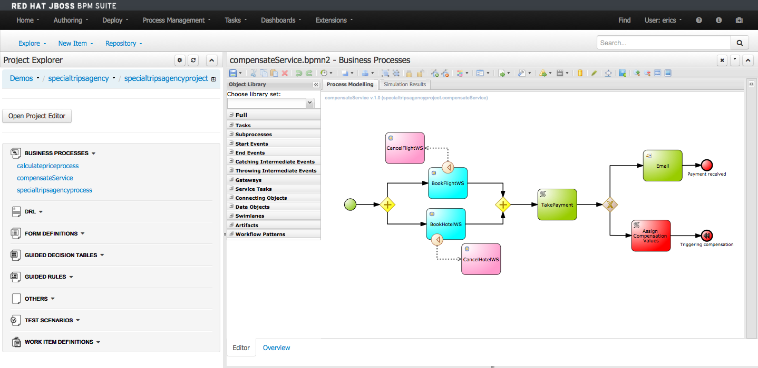





Full BPM lifecycle support
Modeling & Simulation
Integration & Deployment
Continuous Improvement
Monitoring & Analysis
Execution & Management

Slide 8
JBoss BPM Suite Travel Agency Demo

Slide 9
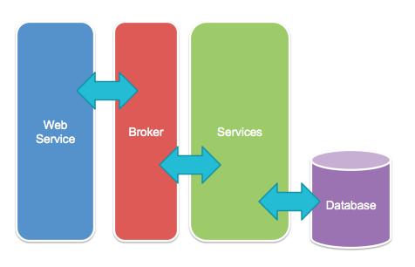
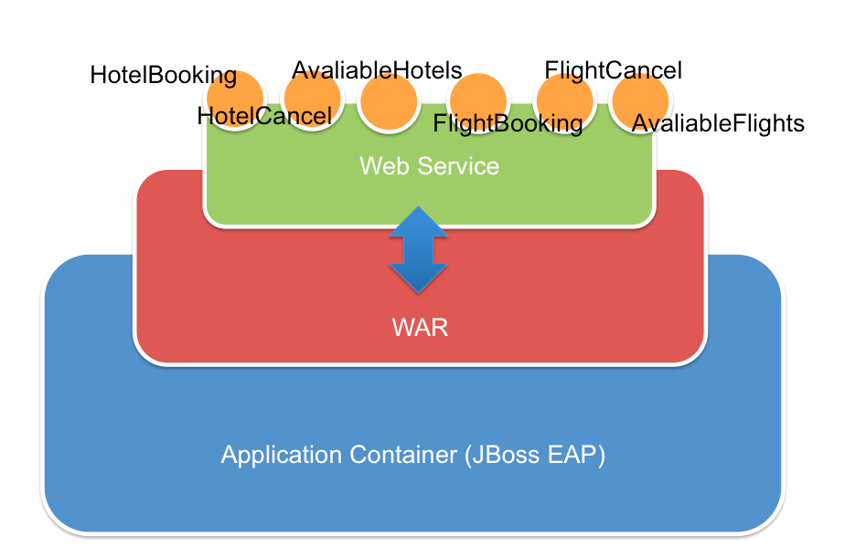
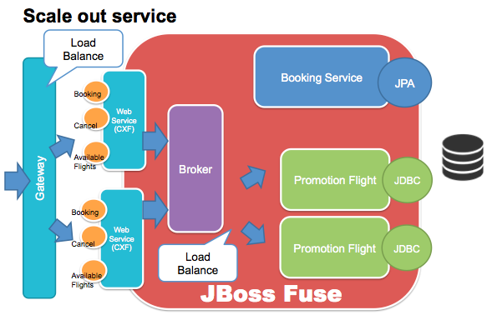
JBoss BPM Travel Agency Micro-Services

Slide 10
Demo scenario 1
Kick start the process by clicking on circle_play.jpeg button using forms under "Processes Management" >> "Process Definitions" >> "specialtripsagencyprocess.
Fill in the data as follows:
Applicant Name: <your name>
Email Address: <any email address>
Number Of Travelers: 6 (use this value to trigger one process path)
From Destination: "London" (case sensitive)
To Destination: "Edinburgh" (case sensitive)
Preferred Date of Departure (YYYY-MM-DD): 2014-06-06
Preferred Date of Arrival (YYYY-MM-DD): 2014-06-12
Other Details/Notes: <any String>
Under "Tasks" >> "Task Lists" there should be a task waiting to be accepted. Claim that task and click on "Work" button under "Details" section on your right.. This user should review the details and has the authority to change the "Total Price (Quote Price)" and add a "Review Comment" note.
Fill in the data as follows:
Total Price (Quote Price): modify from "3000" to "2800"
Review Comment: Provided £200 discount on the total package during initial review.
After completing the review the user (reviewer) should click on "Complete" so that the process instance continues to next available tasks.
Under "Tasks" >> "Task Lists" there should be a task waiting to be accepted. Claim that task and click on "Work" button under "Details" section on your right. Now this employee/user should familiarize herself with the entire package, then contact the customer and quote the total price (Quote Price) to the customer. Now, depending on how the conversation/discussion goes with the customer the employee can either:
request for Review (By ticking "Request For Review" checkbox and providing appropriate reason for review) in which case the process will loop back and go to the reviewer task again for additional review (check "specialtripsagencyprocess.bpmn2" business process for more details)
OR
complete the booking (by checking "Is Booking Confirmed?" checkbox) in which case the process instance will end.

Slide 11
Demo scenario 2
Kick start the process by clicking on circle_play.jpeg button using forms under "Processes Management" >> "Process Definitions" >> "specialtripsagencyprocess.
Fill in the data as follows:
Applicant Name: <your name>
Email Address: <any email address>
Number Of Travelers: 2 (use this value to trigger different process path than scenario 1)
From Destination: "London" (case sensitive)
To Destination: "Edinburgh" (case sensitive)
Preferred Date of Departure (YYYY-MM-DD): 2014-06-06
Preferred Date of Arrival (YYYY-MM-DD): 2014-06-12
Other Details/Notes: <any String>
This process will not be sent for initial review like scenario 1 but will be passed directly to the employee who booked the trip.
Under "Tasks" >> "Task Lists" there should be a task waiting to be accepted. Claim that task and click on "Work" button under "Details" section on your right. Now this employee/user should familiarize herself with the entire package, then contact the customer and quote the total price (Quote Price) to the customer. Now, depending on how the conversation/discussion goes with the customer the employee can either:
request for Review (By ticking "Request For Review" checkbox and providing appropriate reason for review) in which case the process will loop back and go to the reviewer task again for additional review (check "specialtripsagencyprocess.bpmn2" business process for more details)
OR
complete the booking (by checking "Is Booking Confirmed?" checkbox) in which case the process instance will end.

Slide 12
Build the Enlightened Enterprise
For more information, please visit
http://www.jboss.org/products
Demo project available at:
http://github.com/jbossdemocentral/bpms-travel-agency-demo

